Slide 1

Video doorbells
By
J.J. Johnson

Slide 2
Video doorbells
HOME SECURITY BEGINS AT YOUR FRONT DOOR

Slide 3
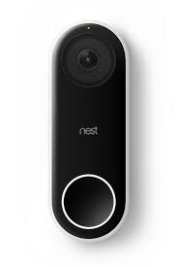
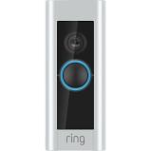
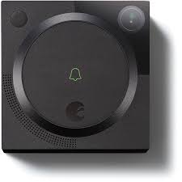
Video doorbells
Ring
Nest Hello
August

Slide 4
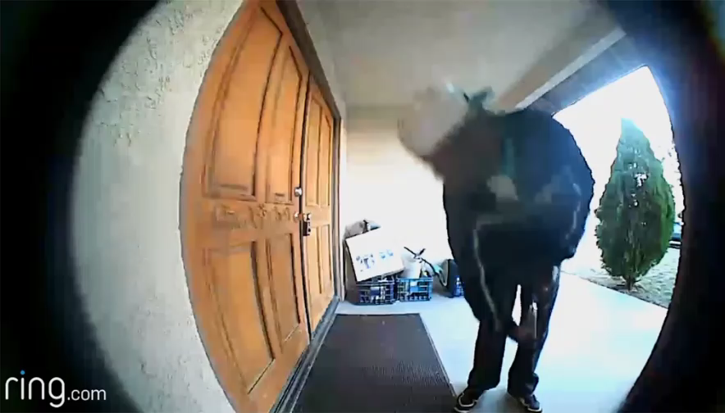
Video doorbells

Slide 5
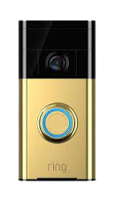

Ring video doorbell

Slide 6
Ring video doorbell
Works on home with or without a doorbell
Quick and easy self-install
Instant mobile alerts
1080 HD wide-angle video
Built in microphone and speaker

Slide 7
Ring video doorbell
Hardwired or battery-powered
Wi-Fi connection
Motion Detection – Adjustable
iOS, Android and Window 10 compatible
Weather-resistant

Slide 8
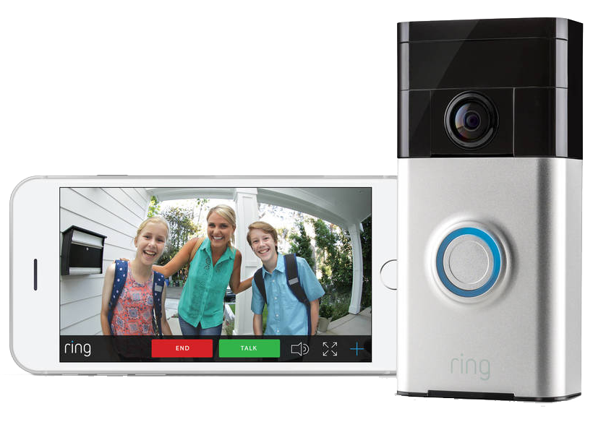
Ring video doorbell
Two-way communication
Video
  1080 p HD
  160 degrees
  Live view
  Night Vision
Audio
  Two-way
  Noise cancellation

Slide 9
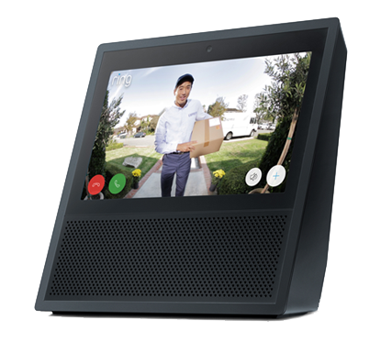
Instant Alerts

Slide 10
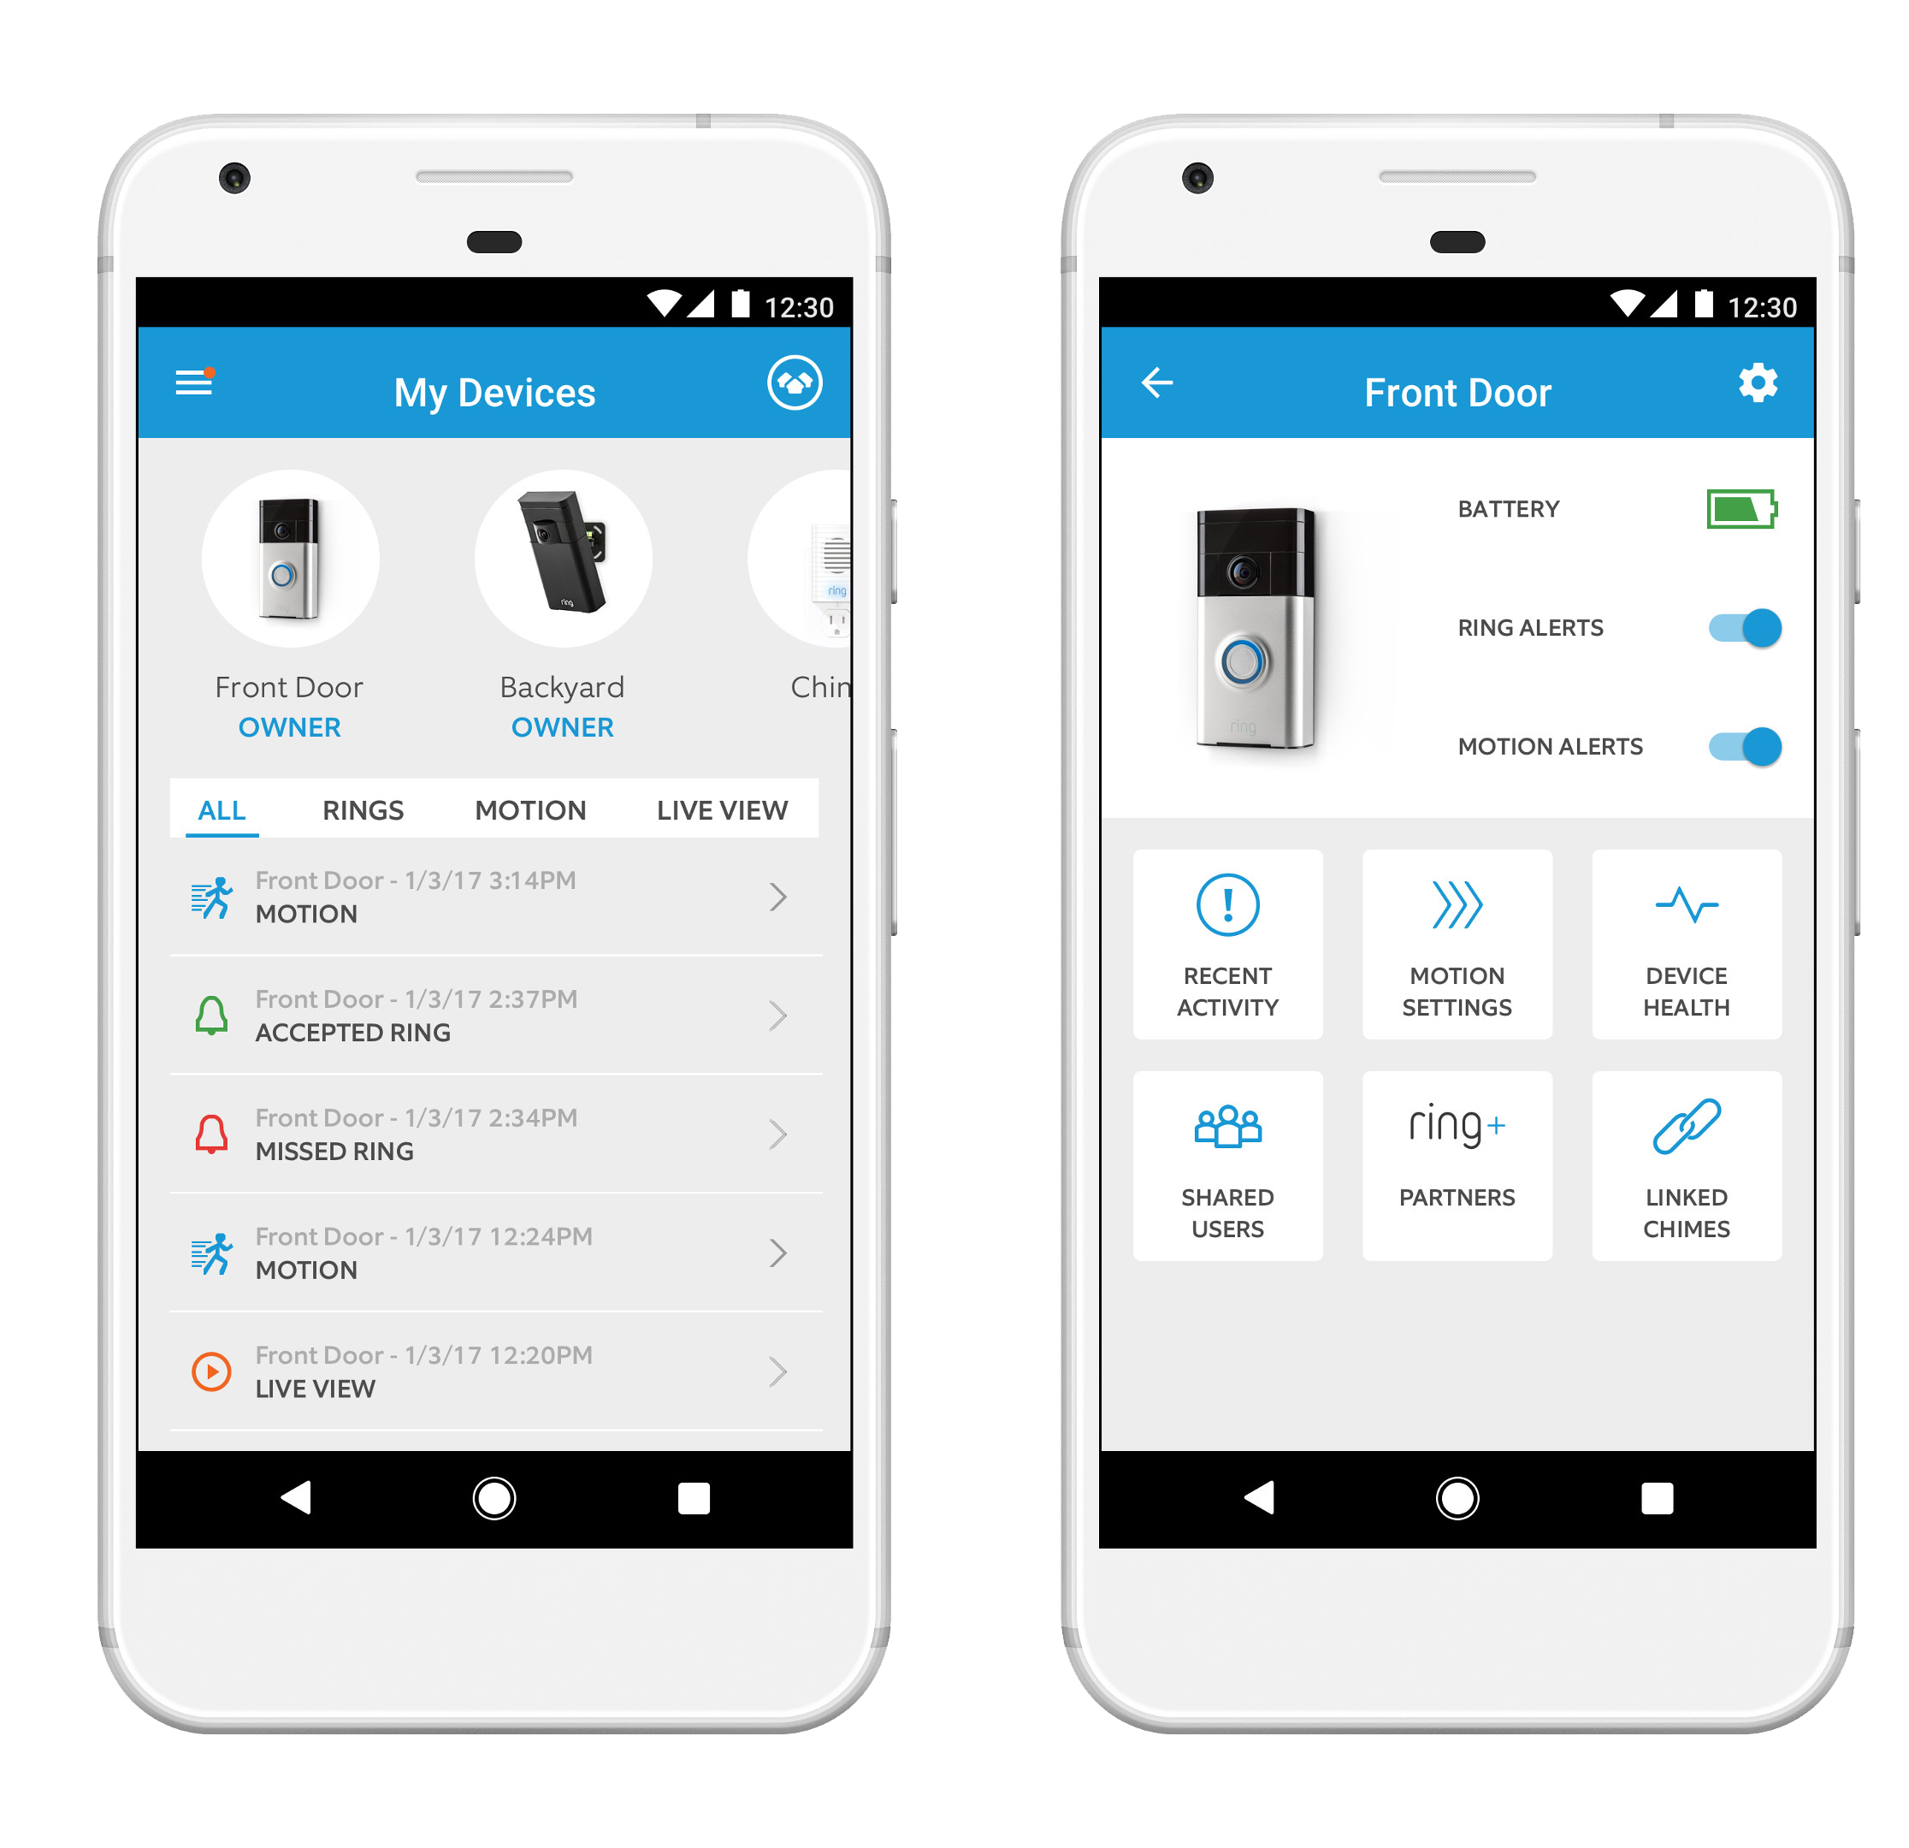
Ring video doorbell
Recent Activity
Motion Setting
Device Health
Share Uses
Partners
Motion Snooze
Linked Chimes
App Alert Tones
Event History

Slide 11
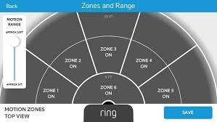
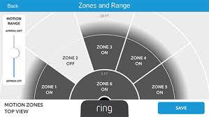
Ring video doorbell
Adjustable motion sensor

Slide 12
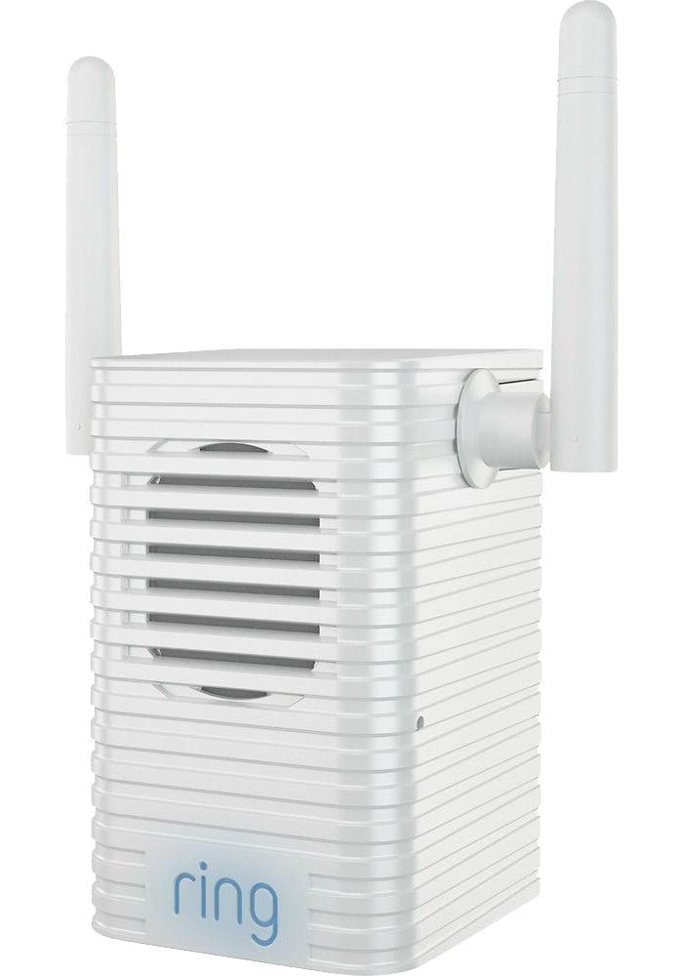
Ring video doorbell
Chime Pro Wi-Fi Extender
Extends Wi-Fi to Ring Devices
Multiple Alert Tones
Do Not Disturb Mode

Slide 13
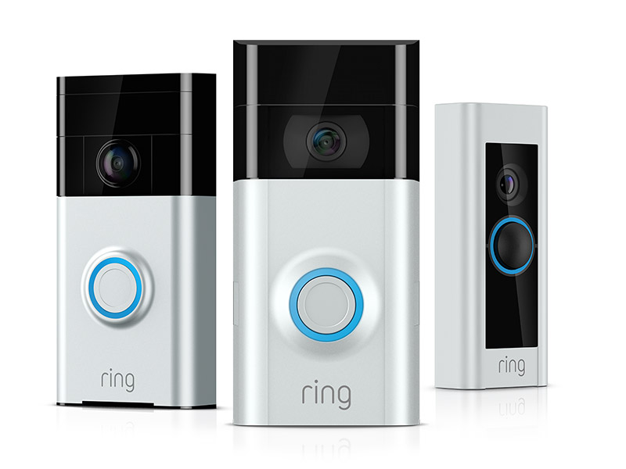
Ring video doorbell
Video Doorbell $99.99
  Battery-powered
Video Doorbell 2 $199.00
  Enhanced video resolution
  Quick-release battery
Video Doorbell Pro $249.00
  Hardwired
  Advance features
Video Doorbell Elite $499.00
  Profession-grade
  Flush-mounted

Slide 14
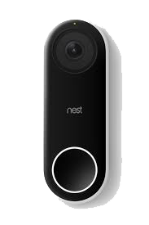
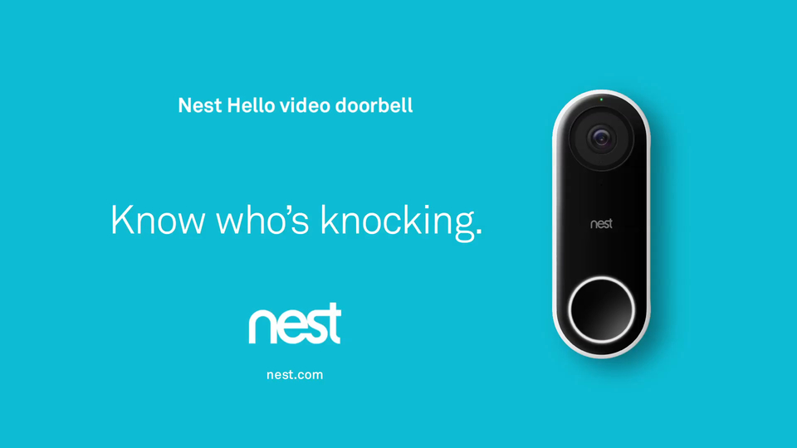
Nest hello! Video doorbell

Slide 15
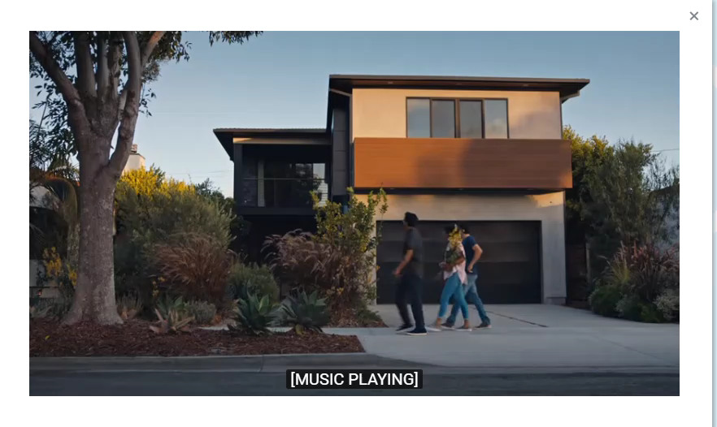
Nest hello video doorbell

Slide 16
Nest hello video doorbell
Wi-Fi connectivity
Manage with mobile app
HD Two-way talk and listen
Motion and sound alerts
Night vision

Slide 17
Nest hello video doorbell
Requires a wired doorbell, chime and transformer.
  Professional installation recommended
24/7 streaming and continuous video recording
Recognize family and friends and send alerts
Prerecorded quick response
  “We’ll be right there”

Slide 18

Nest hello video doorbell
Cloud recording
  24/7 continuous recording
  5-day video history
  $5 a month subscription
  $50 a year subscription

Slide 19
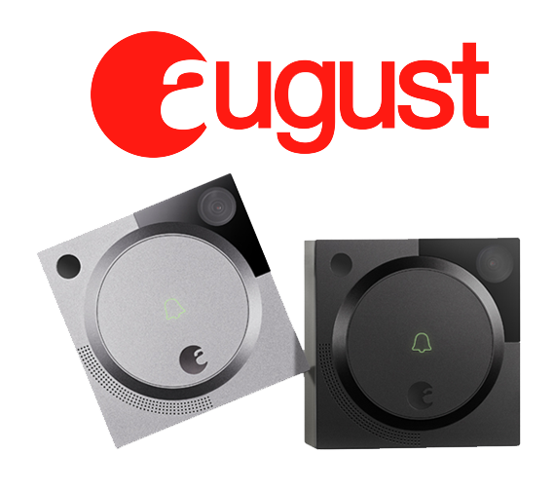
August doorbell cam pro
Real-time alerts
HD video camera
Two-way audio
Free 24 Hour Video storage
Buildin Floodligh
Integrates with:
  Nest
  Amazon Echo Show
  Google Assistant
  Fire TV

Slide 20
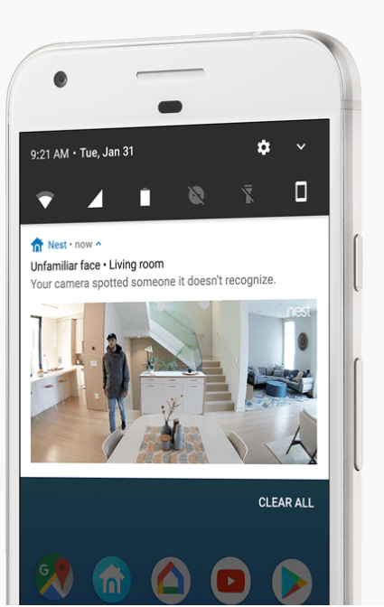
August doorbell cam pro
HindSight
Constantly monitors your doorway
Captures the moment leading up to a motion alert
Review videos with recording subscription

Slide 21
August doorbell cam pro
Subscriptions
BASIC-FREE
  Stores video for 24 hours
PREMIUM - $4.99 per month
  Stores videos for up to 30 days

Slide 22
Video doorbells
Blink Video Doorbell

Slide 23
Home security
Video Doorbells
Video Light
Video Camera
Motion activated devices
  Doors and Windows
  Motion sensors

Slide 24
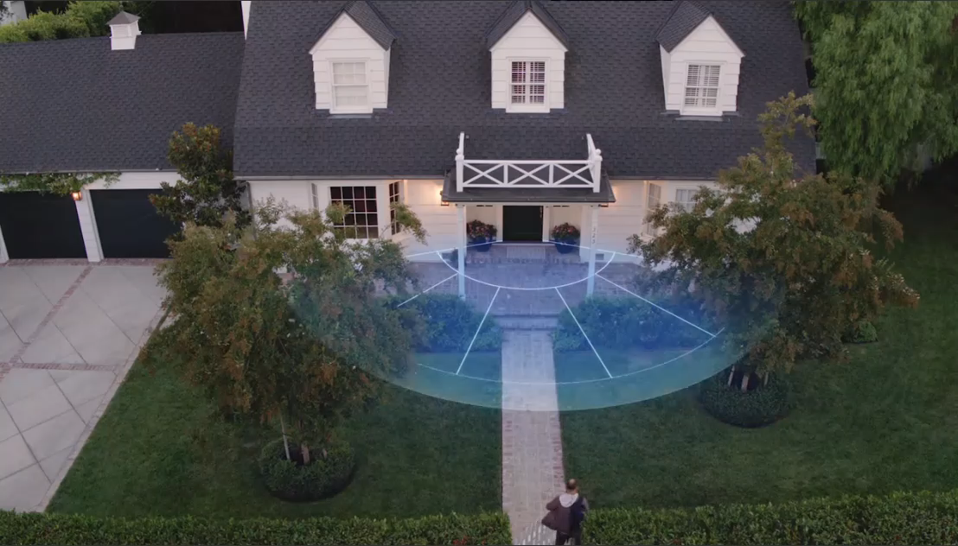
Home security

